Slide 1










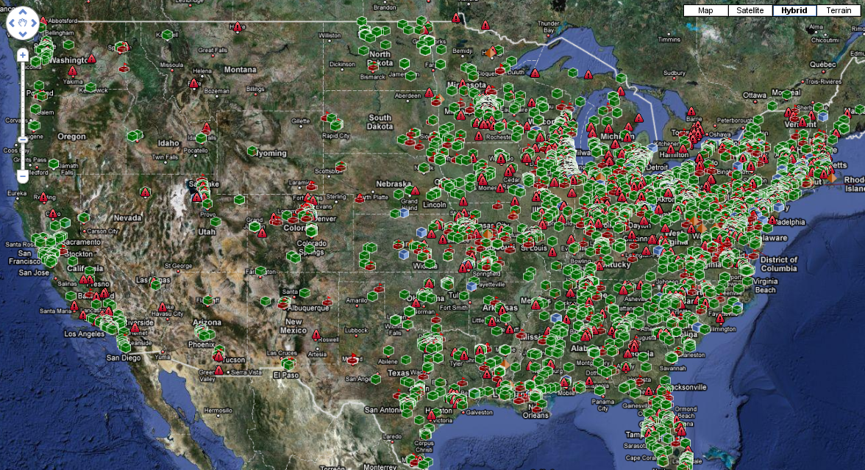
Project Map
PROJECT TYPE
Type Search Here...
MAP
REGION
PRIVATE
INACTIVE
2032
PUBLIC
INACTIVE
3043
PRIVATE
ACTIVE
1507
PUBLIC
ACTIVE
2875
PRIVATE
QUOTED
485
PUBLIC
QUOTED
621
CLOSED
PFRI
1124
FCS
CLIENT
305
DEK-TEK
CLIENT
97
FCS
REPS
5
PROPERTIES
WILL NOT MAP:
1744

